Slide 1
120 years Olympic data analysis
SOWMYA.YALAVARTHI

Slide 2
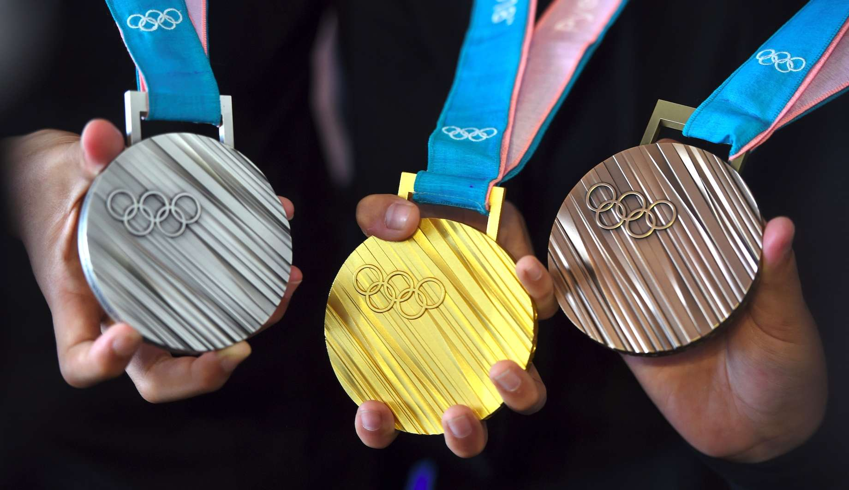
Aim:
To Transform and Analyze the Olympic Data set converting into a practical implementable data model using the appropriate technologies.

Slide 3
INTRODUCTION ABOUT DATASET
The dataset analysed here spans both summer and winter olympics held between 1896 and 2016.
It contains details of every event held and the athletes who competed.
Each athlete has a unique ID number, with some athletes participating at multiple events and across different olympics.
The full dataset consists of 271,116 rows and 15 columns.The columns consist of: athlete ID, name, gender, age, height, weight, team, national olympic committee 3-letter code, name of games, year held, season, host city, sport, event, and medal won.
Missing data or if an athlete failed to win a medal are stored as nan

Slide 4
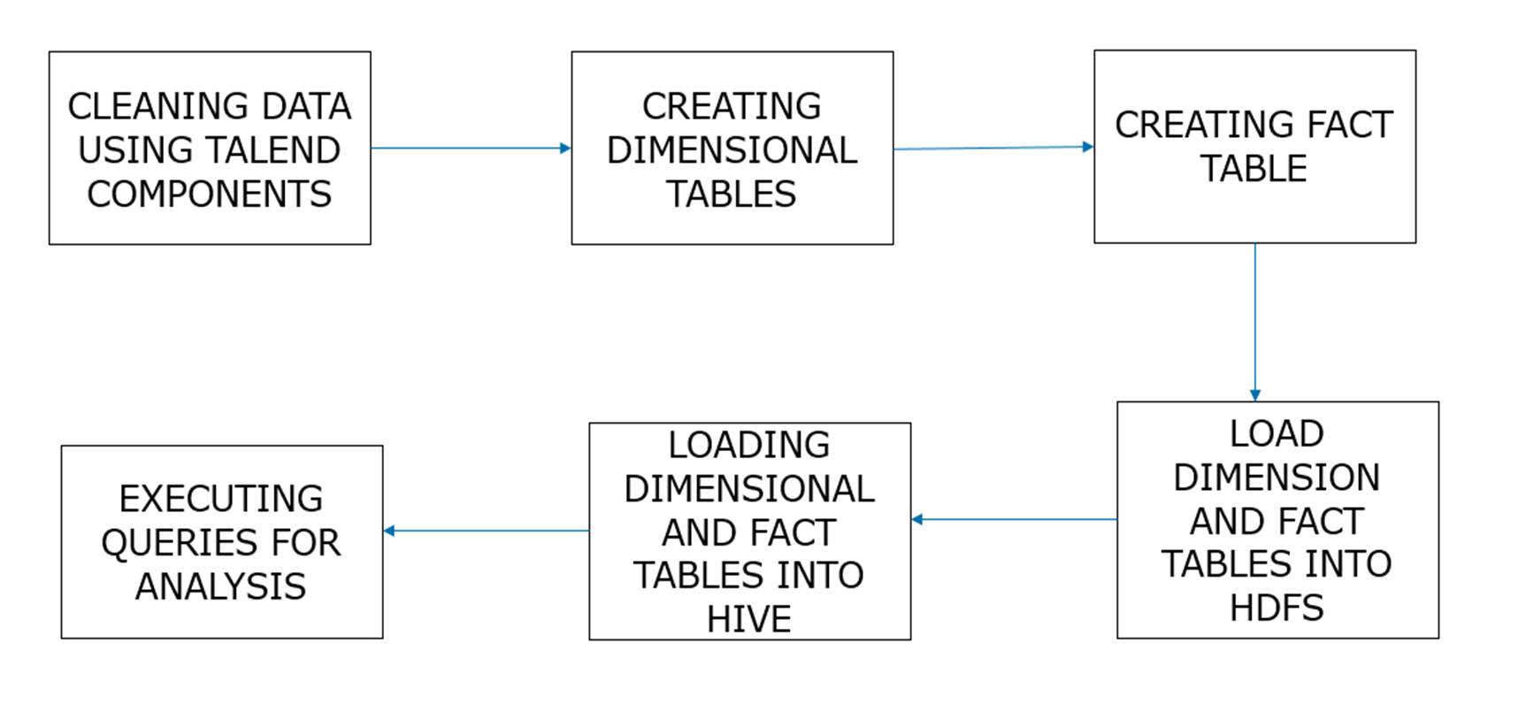
Flow chart

Slide 5
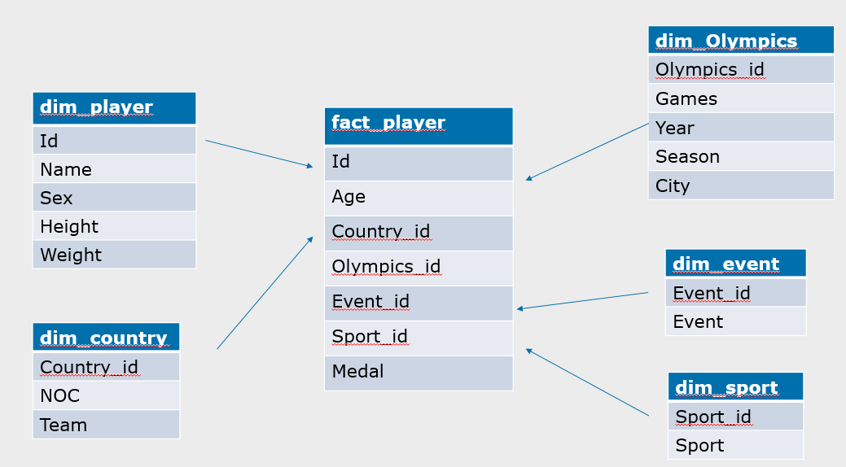
Data model

Slide 6
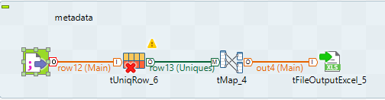
Creating dimensional tables

Slide 7
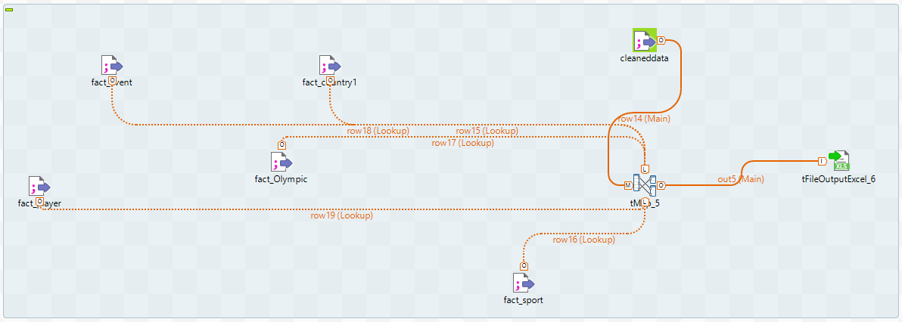
Creating fact table

Slide 8
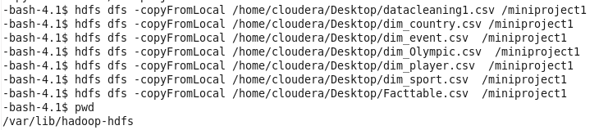
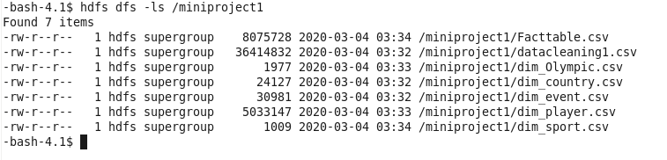
Loading data into hdfs

Slide 9

Creating tables in hive:

Slide 10

Loading data into hive

Slide 11

Analysis of data
How many gold has a particular country won till date?
Output:

Slide 12
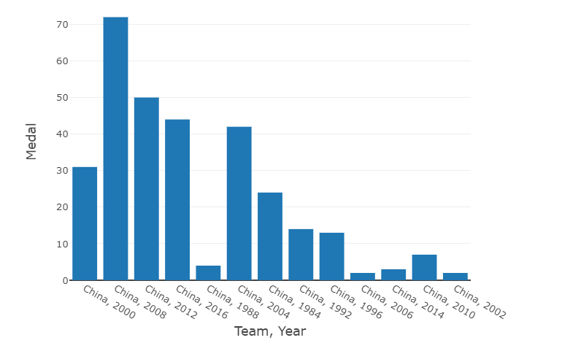
Graph represents how many gold medals are won by china

Slide 13
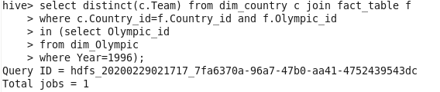
List of all countries who had participated in a particular year?

Slide 14
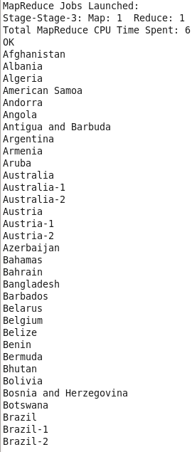
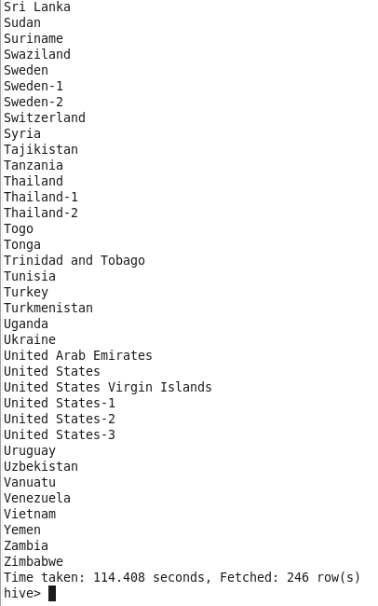
Query output

Slide 15
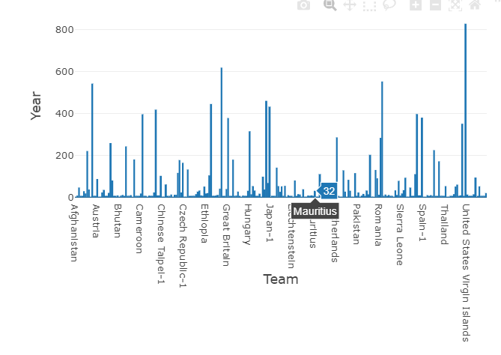
Graph represents the countries who participated in particular year

Slide 16
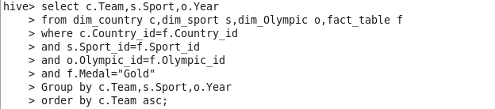
Which countries have won the gold along with year and sport?

Slide 17
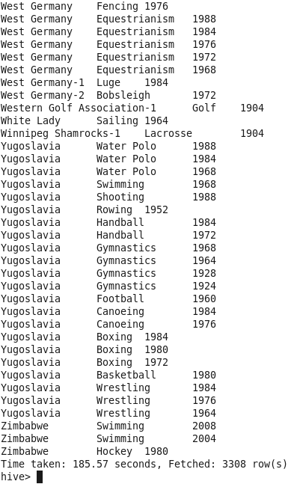
Query Output:

Slide 18
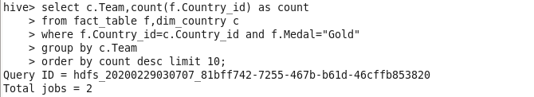
Top 10 countries who have won gold?

Slide 19
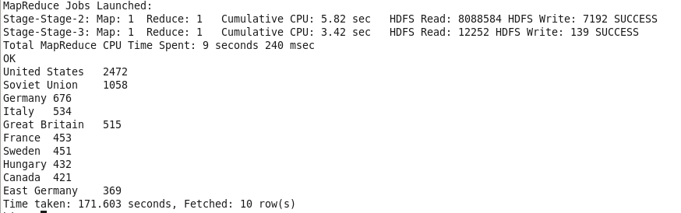
Query Output:

Slide 20
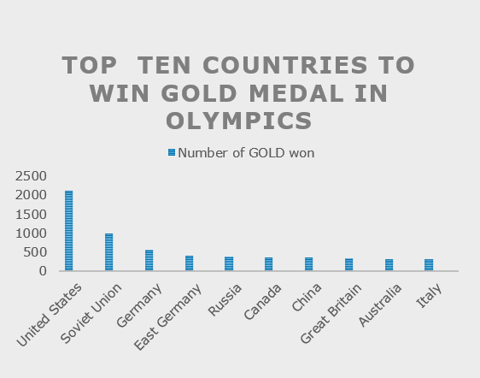
Graph represents top 10 countries who have won gold

Slide 21
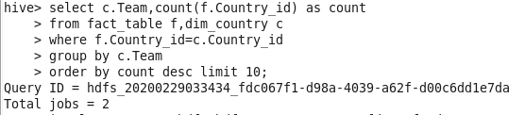
Top 10 countries , who have participated in Olympics the maximum time

Slide 22
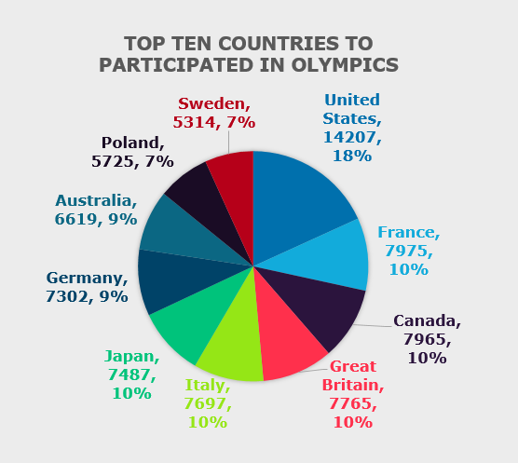
Graph represents top 10 countries who have participated in Olympics the maximum time

Slide 23


